Slide 1

Regular and Nonregular Languages
Chapter 8

Slide 2
Languages: Regular or Not?
a*b* is regular.
{a^{n}b^{n}: n ≥ 0} is not.
{w ∈ {a, b}* : every a is immediately followed by b} is regular
{w ∈ {a, b}* : every a has a matching b somewhere} is not
● Showing that a language is regular
● Showing that a language is not regular

Slide 3
How Many Regular Languages?
Theorem: There is a countably infinite number of regular languages.
Proof:
● Upper bound on number of regular languages:
number of FSMs.
● Lower bound on number of regular languages:
{a},{aa},{aaa},{aaaa},{aaaaa},{aaaaaa},…
are all regular. That set is countably infinite.
Notes:
We can lexicographically enumerate all the legal DFSMs with input sigma.

Slide 4
Regular And Nonregular Languages?
There is a countably infinite number of regular languages.
There is an uncountably infinite number of languages over any nonempty alphabet Σ.
  Theorem 2.3 on p15
So there are many more nonregular languages than there are regular ones.

Slide 5
Showing that a Language is Regular
Theorem: Every finite language is regular.
Proof: If L is the empty set, then it is defined by the regular expression ∅ and so is regular. If it is any finite language composed of the strings s₁, s₂, … s_{n} for some positive integer n, then it is defined by the regular expression:
s₁ ∪ s₂ ∪ … ∪ s_{n}
So it too is regular.

Slide 6
A Finite Language We May Not Be Able to Write Down
● L₁ = {w ∈ {0 - 9}*: w is the social security number of a living US resident}.
● Finite, thus regular. But the techniques we have described for recognizing regular languages would not be very useful in building a program to check for a valid SSN.
REs are most useful when the elements of L share some repeating patterns.
FSMs are most useful when the elements of L share some simple structural properties.
They don't bring much to the table when the language is just a set of unrelated strings.
Other techniques, e.g., hash tables, are better suited to handling finite languages whose elements are chosen by our world, not by rule.
Most useful languages are infinite
Regular: regularity, repeat, pattern, cycle, loop, recursion …

Slide 7
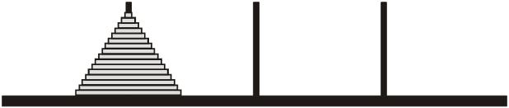
Regular Does Not Always Mean Easy: Size of Input Matters
The towers of Hanoi: a stack of 64 disks; move to the last pole. One at a time. Cannot be placed on top of a smaller one. No held or ground.
Let Σ = {12, 13, 21, 23, 31, 32}.
  12 means the top disk from pole 1 is removed and placed on pole 2
Let L be the language of strings that correspond to successful move sequences. The shortest string in L has length 2⁶⁴ -1.
  If 1 sec per move, it’d take about 600000000000 years.
  recursion
There is an FSM that accepts L
  The number of distinct states is finite
  Can easily build an NDFSM for it
ToH is intractable, FSM is linear … where went wrong?
Notes:
How many states are there? Each disk is on one of the three poles. The order of the disks on a given pole is fixed. So there are 3⁶⁴ states.
Communicated with Dr. Elaine Rich.
My concern is, on p 164, it says “Not every regular language is computationally tractable. Consider the Towers of Hanoi language”
First of all, it’s not precise to see a language is tractable or not. The problem is language recognition problem.
The above statement is confusing because regular language recognition problem is linear w.r.t. input w (p187), not intractable (being tractable or intractable is w.r.t. the input)
What meant by Elaine was the T of H problem is intractable w.r.t. k, the number of disks.
The L she builds has a w that is exponential w.r.t. k, which means, this particular encoding is intractable. It changed an intractable problem w.r.t. k to a tractable problem w.r.t. w, where w is exponential to k. The hardness nature of the problem is not changed.
So the original point she wants to make is as follows in her email:
“You're right. The T of H language is not intractable in the same way, for
example, that NP-complete problems appear to be. I guess maybe I chose
unfortunate words. I was just trying to suggest that merely because an FSM
exists to solve a problem, the problem is not necessarily trivial.
Thanks again.
Elaine“
“There isn't always a reasonable sized machine, even when some machine
exists.”
She uses that encoding of L to demonstrate there exists some FSM that accepts L, so L is regular. But the size of the FSM is intractable w.r.t k. In other words, the size of the input of the FSM is intractable.

Slide 8
Showing That L is Regular
1. Show that L is finite.
2. Exhibit a regular expression for L.
3. Exhibit an FSM for L.
4. Exhibit a regular grammar for L.
5. Exploit the closure theorems.

Slide 9
Closure Properties of Regular Languages
● Union
● Concatenation
● Kleene star
● Complement
● Intersection
● Difference
● Reverse
● Letter substitution
If we can show that L can be constructed from other regular languages using those operations, then L must also be regular
L₁ L₂

Slide 10
Divide-and-Conquer
Let L = {w ∈ {a, b}* : w contains an even number of a’s and an odd number of b’s and all a’s come in runs of three}.
L = L₁ ∩ L₂, where:
L₁ = {w ∈ {a, b}* : w contains an even number of a’s and an odd number of b’s}, and
L₂ = {w ∈ {a, b}* : all a’s come in runs of three}

Slide 11
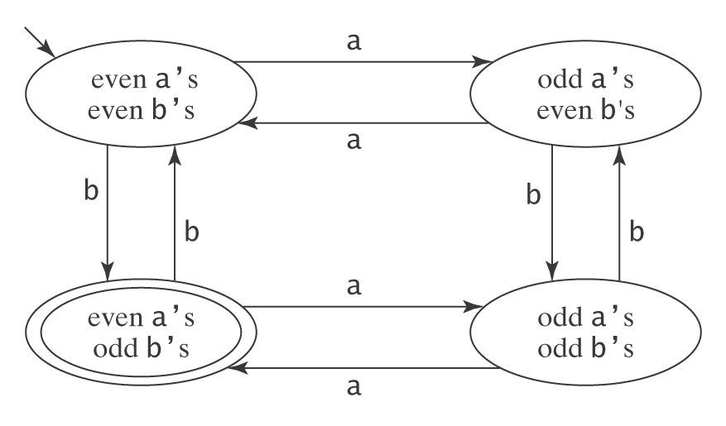
L₁ is Regular
Notes:
Since we showed an FSM that accepts it in Example 5.9, p64

Slide 12
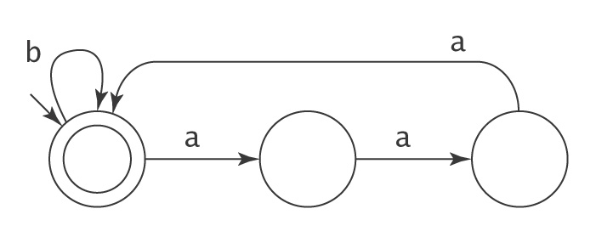
L₂ is Regular

Slide 13
Don’t Try to Use Closure Backwards
One Closure Theorem:
If L₁ and L₂ are regular, then so is
L = L₁ ∩ L₂
But if L is regular, what can we say about L₁ and L₂?
L = L₁ ∩ L₂
ab = ab ∩ (a ∪ b)* (regular)
ab = ab ∩ {a^{n}b^{n}, n ≥ 0} (not regular)

Slide 14
Showing that a Language is Not Regular
Every regular language can be accepted by some FSM.
It can only use a finite amount of memory to record essential properties.
Example:
{a^{n}b^{n}, n ≥ 0} is not regular

Slide 15
Showing that a Language is Not Regular
The only way to generate/accept an infinite language with a finite description is to use Kleene star (in regular expressions) or cycles (or loops, in automata). This forces some kind of simple repetitive cycle within the strings.
Example:
ab*a generates aba, abba, abbba, abbbba, etc.
  We focus on FSMs
Notes:
If not regular, L must be infinite, otherwise, it’s regular.
If we fail to find any cycle in an infinite L, then it cannot be regular.
However, we cannot use this method to show regularity.
e.g., if we find some cycle in an infinite L, we cannot say it is regular.
In other words, this method may not work in showing the non-regularity of some L.

Slide 16
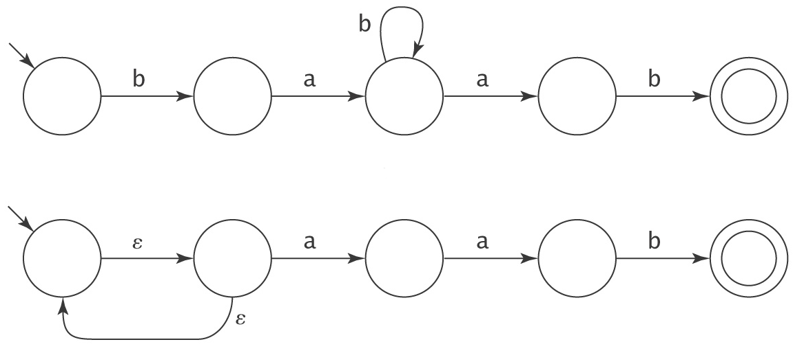
How Long a String Can Be Accepted?
What is the longest string that a 5-state FSM can accept?
Notes:
Above: infinite, but the longest one without going through any loops is 4.
Below: only accepts aab. no matter how many times it goes through the loop, it cannot accept any longer strings.
So, it’s a “false loop”, not that kind of regularity or repeats that a regular infinite L must exhibit in order to accept an infinite string.
So, we focus on DFSM. Note, this is not a restriction, due to the equivalence of NDFSM and DFSM.

Slide 17
Theorem – Long Strings
Theorem: Let M = (K, Σ, δ, s, A) be any DFSM. If M accepts any string of length |K| or greater, then that string will force M to visit some state more than once (thus traversing at least one loop).
Proof: M must start in one of its states. Each time it reads an input character, it visits some state. So, in processing a string of length n, M creates a total of n + 1 state visits. If n+1 > |K|, then, by the pigeonhole principle, some state must get more than one visit. So, if n ≥ |K|, then M must visit at least one state more than once.

Slide 18
The Pumping Theorem for Regular Languages
If L is regular, then every long string in L is pumpable.
So, ∃k ≥ 1
(∀ strings w ∈ L, where |w| ≥ k
(∃ x, y, z (w = xyz,
|xy| ≤ k,
y ≠ ε, and
∀q ≥ 0 (xy^{q}z is in L)))).
Also referred to as pumping lemma

Slide 19
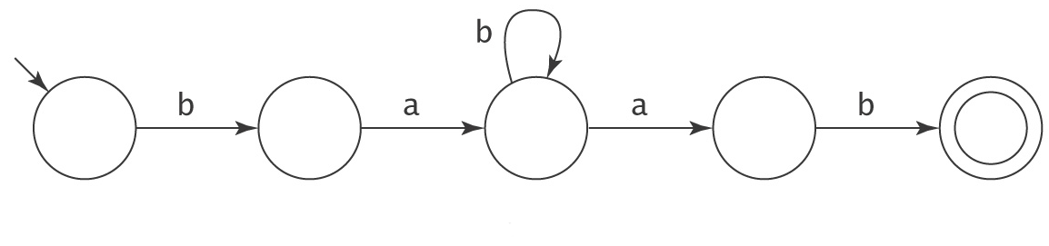
Example: Regular
L = bab*ab
b a b b b b a b
x y z
xy*z must be in L. (pumping y 0 or more times)
babbbab, babbbbbab, babbbbbbbab, …
Notes:
infinite

Slide 20
Another Regular Example
L = {b,bb,bbb,bbbb}
L is regular, how to show the pumping lemma applies?
Let k = 5, the number of long strings are 0, so “every long string is pumpable” is true.
Notes:
infinite

Slide 21
Example: {a^{n}b^{n}: n ≥ 0} is not Regular
k is the number from the Pumping Theorem.
Choose w to be a^{⎡k/2⎤}b^{⎡k/2⎤} (“long enough”).
1 2
a a a a a … a a a a a b b b b … b b b b b b
x y z
We show that there is no x, y, z with the required properties:
|xy| ≤ k,
y ≠ ε,
∀ q ≥ 0 (xy^{q}z is in L).
Three cases to consider:
● y falls in region 1: (more a’s than b’s)
● y falls across regions 1 and 2: (interleaved a’s and b’s)
● y falls in region 2: (more b’s than a’s)

Slide 22
Example: {a^{n}b^{n}: n ≥ 0} is not Regular
k is the number from the Pumping Theorem.
Choose w to be a^{⎡k/2⎤}b^{⎡k/2⎤} (“long enough”).
1 2
a a a a a … a a a a a b b b b … b b b b b b
x y z
While this works, there is an easier way:

Slide 23
Example: {a^{n}b^{n}: n ≥ 0} is not Regular
Second try:
Choose w to be a^{k}b^{k} (We get to choose any w).
1 2
a a a a a … a a a a a b b b b … b b b b b b
x y z
We show that there is no x, y, z with the required properties:
|xy| ≤ k,
y ≠ ε,
∀ q ≥ 0 (xy^{q}z is in L).
Since |xy| ≤ k, y must be in region 1. So y = a^{p} for some p ≥ 1. Let q = 2, producing:
a^{k+p}b^{k}
which ∉ L, since it has more a’s than b’s.

Slide 24
A Complete Proof
We prove that L = {a^{n}b^{n}: n ≥ 0} is not regular
If L were regular, then there would exist some k such that any string w where |w| ≥ k must satisfy the conditions of the theorem. Let w = a^{⎡k/2⎤}b^{⎡k/2⎤}. Since |w| ≥ k, w must satisfy the conditions of the pumping theorem. So, for some x, y, and z, w = xyz, |xy| ≤ k, y ≠ ε, and ∀q ≥ 0, xy^{q}z is in L. We show that no such x, y, and z exist. There are 3 cases for where y could occur: We divide w into two regions:
aaaaa…..aaaaaa | bbbbb…..bbbbbb
1 | 2
So y can fall in:
● (1): y = a^{p} for some p. Since y ≠ ε, p must be greater than 0. Let q = 2.
The resulting string is a^{k+p}b^{k}. But this string is not in L, since it has
more a’s than b’s.
● (2): y = b^{p} for some p. Since y ≠ ε, p must be greater than 0. Let q = 2.
The resulting string is a^{k}b^{k+p}. But this string is not in L, since it has
more b’s than a’s.
● (1, 2): y = a^{p}b^{r} for some non-zero p and r. Let q = 2. The resulting
string will have interleaved a’s and b’s, and so is not in L.
So there exists one string in L for which no x, y, z exist. So L is not regular.

Slide 25
Using the Pumping Theorem
If L is regular, then every “long” string in L is pumpable.
To show that L is not regular, we find one that isn’t.
To use the Pumping Theorem to show that a language L is not regular, we must:
1. Choose a string w where |w| ≥ k. Since we do not know
what k is, we must state w in terms of k.
2. Divide the possibilities for y into a set of equivalence
classes that can be considered together.
3. For each such class of possible y values where |xy| ≤ k
and y ≠ ε:
Choose a value for q such that xy^{q}z is not in L.

Slide 26
Poetry: The Pumping Lemma
Any regular language L has a magic number p //we used k
And any long-enough word in L has the following property:
Amongst its first p symbols is a segment you can find
Whose repetition or omission leaves x amongst its kind.
So if you find a language L which fails this acid test,
And some long word you pump becomes distinct from all the rest,
By contradiction you have shown that language L is not
A regular guy, resiliant to the damage you have wrought.
But if, upon the other hand, x stays within its L,
Then either L is regular, or else you chose not well.
For w is xyz, and y cannot be null,
And y must come before p symbols have been read in full.
As mathematical postscript, an addendum to the wise:
The basic proof we outlined here does certainly generalize.
So there is a pumping lemma for all languages context-free,
Although we do not have the same for those that are r.e. //r.e. (recursively enumerable), refers to the semidecidable class of languages
-- Martin Cohn / Harry Mairson;
Computer Science Department; Brandeis University

Slide 27
More Examples
Bal = {w ∈ {), (}* :the parenthesis are balanced}
    balanced parenthesis
PalEven = {ww^{R} : w ∈ {a, b}*}
  even length palindrome
L = {a^{n}b^{m}: n ≥ m}
    more a’s than b’s
L = {a^{n}: n is prime}
    prime number of a’s

Slide 28
Using the Closure Properties
Can be used alone, or together with the Pumping theorem to prove non-regularity
The two most useful ones are closure under:
Intersection
Complement

Slide 29
Using the Closure Properties
L = {w ∈ {a, b}*: #_{a}(w) = #_{b}(w)}
#_{c}(s) is the number of times that c occurs in s.
  e.g., #_{a}(abbaaa) = 4.
If L were regular, then:
L′ = L ∩ a*b*
would also be regular, since a*b* is regular.
But L′ = L ∩ a*b* = {a^{n}b^{n}: n ≥ 0}, it isn’t regular.

Slide 30
Is English Regular?
Is English finite?
If we assume there’s a longest sentence, then English is regular because it is finite;
But someone can always make a longest sentence even longer …
The following example shows that there are sentences that are much longer than whatever upper limit you probably have in mind …
  630 words, announces a local government’s intention to move a path.

Slide 31
In the event that the Purchaser defaults in the payment of any installment of purchase price, taxes, insurance, interest, or the annual charge described elsewhere herein, or shall default in the performance of any other obligations set forth in this Contract, the Seller may: at his option: (a) Declare immediately due and payable the entire unpaid balance of purchase price, with accrued interest, taxes, and annual charge, and demand full payment thereof, and enforce conveyance of the land by termination of the contract or according to the terms hereof, in which case the Purchaser shall also be liable to the Seller for reasonable attorney's fees for services rendered by any attorney on behalf of the Seller, or (b) sell said land and premises or any part thereof at public auction, in such manner, at such time and place, upon such terms and conditions, and upon such public notice as the Seller may deem best for the interest of all concerned, consisting of advertisement in a newspaper of general circulation in the county or city in which the security property is located at least once a week for Three (3) successive weeks or for such period as applicable law may require and, in case of default of any purchaser, to re-sell with such postponement of sale or resale and upon such public notice thereof as the Seller may determine, and upon compliance by the Purchaser with the terms of sale, and upon judicial approval as may be required by law, convey said land and premises in fee simple to and at the cost of the Purchaser, who shall not be liable to see to the application of the purchase money; and from the proceeds of the sale: First to pay all proper costs and charges, including but not limited to court costs, advertising expenses, auctioneer's allowance, the expenses, if any required to correct any irregularity in the title, premium for Seller's bond, auditor's fee, attorney's fee, and all other expenses of sale occurred in and about the protection and execution of this contract, and all moneys advanced for taxes, assessments, insurance, and with interest thereon as provided herein, and all taxes due upon said land and premises at time of sale, and to retain as compensation a commission of five percent (5%) on the amount of said sale or sales; SECOND, to pay the whole amount then remaining unpaid of the principal of said contract, and interest thereon to date of payment, whether the same shall be due or not, it being understood and agreed that upon such sale before maturity of the contract the balance thereof shall be immediately due and payable; THIRD, to pay liens of record against the security property according to their priority of lien and to the extent that funds remaining in the hands of the Seller are available; and LAST, to pay the remainder of said proceeds, if any, to the vendor, his heirs, personal representatives, successors or assigns upon the delivery and surrender to the vendee of possession of the land and premises, less costs and excess of obtaining possession.

Slide 32
If Not Bounded, Not Regular
● The rat ran.
● The rat that the cat saw ran.
● The rat that the cat that the dog chased
saw ran.
Let:
A = {cat, rat, dog, bird, bug, pony}
V = {ran, saw, chased, flew, sang, frolicked}.
Let L = English ∩ {The A (that the A)* V* V}.
L = {The A (that the A)^{n} V^{n} V, n ≥ 0}.
Let w = The cat (that the rat)^{k} saw^{k} ran.
Notes:
If English is regular, then L must be regular since {The A (that the A)* V* V} is regular.
However, L = {The A (that the A)^{n} V^{n} V, n ≥ 0} is not regular, which can be shown by pumping (last line).
So, English is not regular.

Slide 33
Algorithms and Decision Procedures for Regular Languages
Chapter 9

Slide 34
Decision Procedures
A decision procedure is an algorithm whose result is a Boolean value. It must:
● Halt
● Be correct
Important decision procedures exist for regular languages:
● Given an FSM M and a string s, does M accept s?
● Given a regular expression α and a string w, does α
generate w?

Slide 35
Decidability of Regular Languages
Given a regular language L (represented as an FSM or a regular expression or a regular grammar) and a string w, there exists a decision procedure that answers the question, “Is w ∈ L?”

Slide 36
Decidability of Emptiness
Given an FSM M, there exists a decision procedure that answers the question, “Is L(M) = φ?”

Slide 37
Decidability of Totality
Given an FSM M, there exists a decision procedure that answers the question, “Is L(M) = Σ*?”

Slide 38
Decidability of Finiteness
Given an FSM M, there exists a decision procedure that answers the question, “Is L(M) finite?” and “Is L(M) infinite?”

Slide 39
Decidability of Equivalence
Given an FSMs M₁ and M₂, there exists a decision procedure that answers the question, “Is L(M₁) = L(M₂)?”

Slide 40
Decidability of Minimality
Given an DFSM M, there exists a decision procedure that answers the question, “Is M minimal?”

Slide 41
Summary of FSM and RL
Theoretically, every machine we build is a finite state machine.
But not every real problem should be described as a regular language or solved with an FSM.
FSMs and regular expressions are powerful tools for describing problems that possess certain repetitive patterns.
More powerful models to come (PDAs and Turing machines)
  equipped with infinite storage devices, but useful even if there exists practical upper bound on sizes of memory and input

